Slide 1
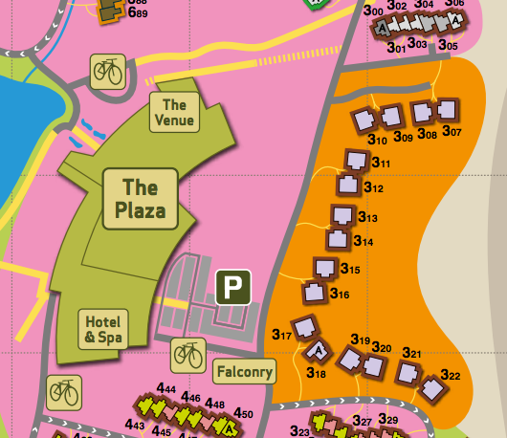
Summit Venue Map
Reception
Summit
Villas
Kings
Portland
Larch
Montague
Maulden
Pedley
Rooms

